Slide 1
Amazon Athena
Interactive query service to analyze data in Amazon S3 using standard SQL

Slide 2
1. Introduction to Amazon Athena

Slide 3

Start Querying Instantly
Serverless
No clusters
No data warehouses
No ETL
Get started instantly
Point to data in S3
Define your schema
Start querying

Slide 4

Pay Per Query
Pay only for queries you run
Query directly from S3
No additional storage charge
Save costs and improve performance
Compression
Partitioning
Columnar formats

Slide 5

Runs standard SQL
Uses Presto with ANSI SQL support
Works with standard data formats
CSV
Apache Weblogs
JSON
Parquet
ORC
Handles complex queries
Large Joins
Window functions
Arrays

Slide 6
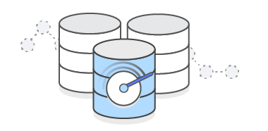
Fast Performance for Large Data Sets
Fast, ad-hoc queries
Executes queries in parallel
No provisioning extra resources for complex queries
Scales automatically

Slide 7
Drivers
Utilize JDBC and ODBC connections to connect Athena to business intelligence tools and other applications
JDBC
The JDBC driver version 2.0.7 complies with the JDBC API 4.1 and 4.2 data standards
ODBC
The ODBC connection driver are available for Windows, Linux, and OSX

Slide 8
2. Athena Design Patterns

Slide 9
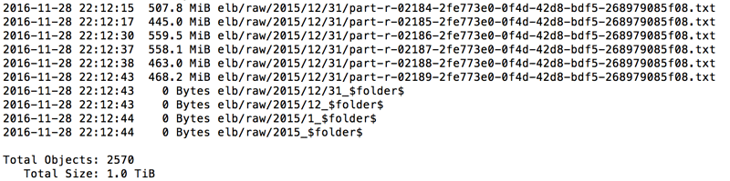
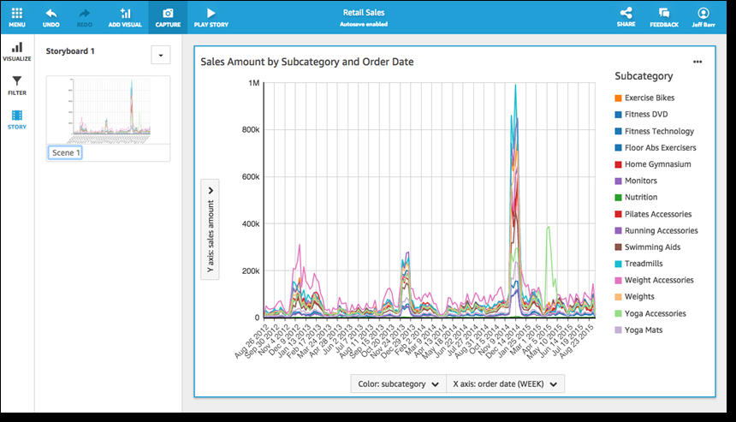
Common Use Cases
Log analytics
Application logs
Apache web logs
IoT devices
ELB logs
CloudTrail logs
Data discovery
Athena with QuickSight for Visualizations
Query AWS Service Logs

Slide 10
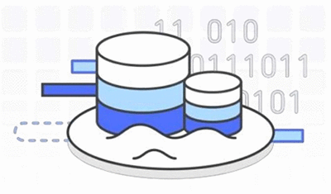
Common Use Cases
Use S3 as a data lake
Kinesis Firehose for ingest
Athena for ad-hoc queries
Redshift for aggregate/current data analysis
EMR for ETL
Notes:
https://aws.amazon.com/blogs/big-data/interactive-analysis-of-genomic-datasets-using-amazon-athena/

Slide 11
When to use Athena vs EMR
Athena
Ad-hoc querying
Serverless
No setup or management of cluster
Run queries using standard SQL
Scales automatically based on complexity of queries
EMR
Data processing/ETL
Build and manage your own cluster
Run custom applications and code
Use big data processing frameworks
Spark, Hadoop, Presto, or HBase
Notes:
Amazon EMR goes far beyond just running SQL queries. With EMR you can run a wide variety of scale-out data processing tasks for applications such as machine learning, graph analytics, data transformation, streaming data, and virtually anything you can code. You should use Amazon EMR if you use custom code to process and analyze extremely large datasets with the latest big data processing frameworks such as Spark, Hadoop, Presto, or Hbase. Amazon EMR gives you full control over the configuration of your clusters and the software installed on them.
You should use Amazon Athena if you want to run interactive ad hoc SQL queries against data on Amazon S3, without having to manage any infrastructure or clusters.
Amazon Athena supports many of the same data formats as Amazon EMR. Athena’s data catalog is Hive metastore compatible. If you're using EMR and already have a Hive metastore, you simply execute your DDL statements on Amazon Athena, and then you can start querying your data right away without impacting your Amazon EMR jobs.

Slide 12
When to use Athena vs Redshift
Athena
Ad-hoc querying
Serverless
No setup or management of cluster
Run queries using standard SQL
Scales automatically based on complexity of queries
Redshift
Data warehouse
Historical analysis and reporting
Need to setup a cluster
Run queries against highly structured data with many joins
Can use same S3 data source as Athena
Notes:
A data warehouse like Amazon Redshift is your best choice when you need to pull together data from many different sources – like inventory systems, financial systems, and retail sales systems – into a common format, and store it for long periods of time, to build sophisticated business reports from historical data; then a data warehouse like Amazon Redshift is the best choice.
Data warehouses collect data from across the company and act as the “single source of truth” for report generation and analysis. Data warehouses pull data from many sources, format and organize it, store it, and support complex, high speed queries that produce business reports. The query engine in Amazon Redshift has been optimized to perform especially well on this use case - where you need to run complex queries that join large numbers of very large database tables.
By comparison, query services like Amazon Athena make it easy to run interactive queries against data directly in Amazon S3 without worrying about formatting data or managing infrastructure. For example, Athena is great if you just need to run a quick query on some web logs to troubleshoot a performance issue on your site. With query services, you can get started fast. You just define a table for your data and start querying using standard SQL.
You can also use both services together. If you stage your data on Amazon S3 before loading it into Amazon Redshift, that data can also be registered with and queried by Amazon Athena.

Slide 13
Ad-hoc Querying
Ad-hoc Query

Slide 14
Ad-hoc Visualization and ETL
Notes:
Amazon Athena integrates with Amazon QuickSight for easy visualization. You can also use Amazon Athena to generate reports or to explore data with business intelligence tools or SQL clients, connected via a JDBC driver.
With EMR you can run a wide variety of scale-out data processing tasks for applications such as machine learning, graph analytics, data transformation, streaming data, and virtually anything you can code. You should use Amazon EMR if you use custom code to process and analyze extremely large datasets with the latest big data processing frameworks such as Spark, Hadoop, Presto, or Hbase.

Slide 15
ETL, Historical Analysis, and Ad-hoc Querying from S3 Data Lake
Notes:
You can also use both services together. If you stage your data on Amazon S3 before loading it into Amazon Redshift, that data can also be registered with and queried by Amazon Athena.
Use S3 as a data lake:
Data (IOT, logs, clickstream) can be ingested through kinesis streams.
Firehose to move it to S3.
EMR cluster running Spark for ETL/Predictive analytics
Athena for ad hoc querying
Redhsift for historical analysis

Slide 16
3. Athena in Action

Slide 17
3.1 Simple Query

Slide 18
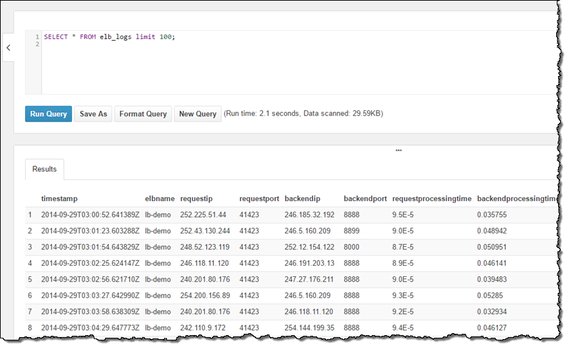
Run Simple Query from AWS Console (N. Virginia)
Notes:
My account was already configured with a sample database and, within the database, a sample table named elb_logs. To get started, I entered a simple query and clicked on Run Query. It ran in less than a second and the results were displayed in the console, with the option to download them in CSV form
https://aws.amazon.com/blogs/aws/amazon-athena-interactive-sql-queries-for-data-in-amazon-s3/

Slide 19
Create External Tables
Use Apache Hive DDL to create table
Run DDL statements using the Athena console
Via a JDBC driver, using SQL workbench
Using the Athena create table wizard
Create “external” table in DDL
Creates a view of the data
Deleting table doesn’t delete the data in S3
Schema-on-read
Projects your schema onto data at query execution time
No need for data loading or transformation
Notes:
Amazon Athena uses Apache Hive DDL to define tables. You can run DDL statements using the Athena console, via a JDBC driver, or using the Athena create table wizard. When you create a new table schema in Amazon Athena the schema is stored in the data catalog and used when executing queries, but it does not modify your data in S3.
Athena uses an approach known as schema-on-read, which allows you to project your schema onto your data at the time you execute a query. This eliminates the need for any data loading or transformation

Slide 20
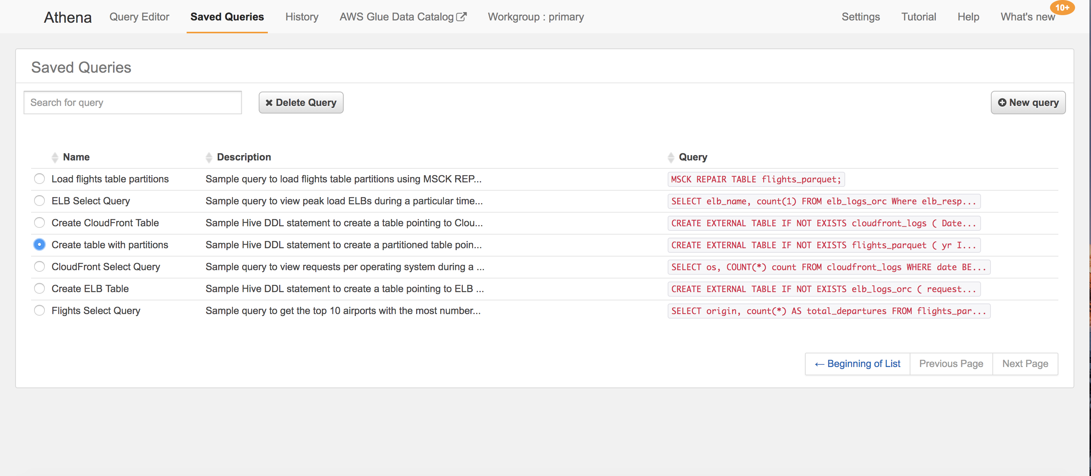
Navigate to ’Saved Queries’ to get DLL
Notes:
Create your own database and to reference your own data. There are two ways to do this — using a DDL statement or through a wizard.
Option to create the table using Athena’s table wizard (accessible from the Catalog Manager). In this case start by naming the table and specifying its location.
https://aws.amazon.com/blogs/aws/amazon-athena-interactive-sql-queries-for-data-in-amazon-s3/

Slide 21
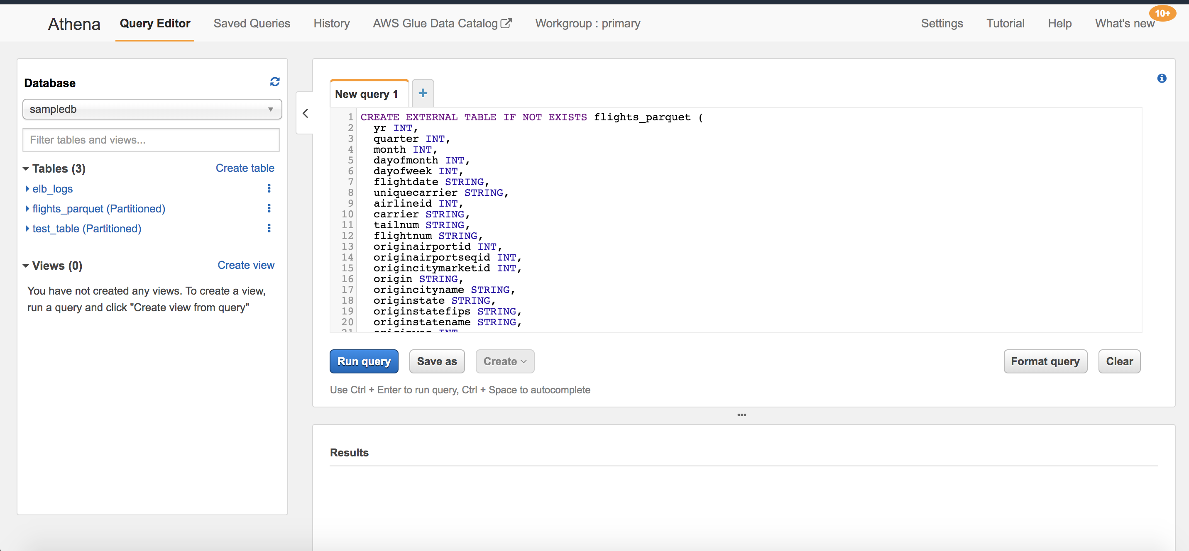
Create External Table using DLL
Notes:
CREATE EXTERNAL TABLE flights_parquet…
PARTITIONED BY (year String) STORED AS PARQUETLOCATION 's3://us-east-1.elasticmapreduce.samples/flights/cleaned/parquet/';
Because the data is partitioned by year, run one final query to set up the metadata for subsequent queries:
MSCK REPAIR TABLE flights_csv;

Slide 22
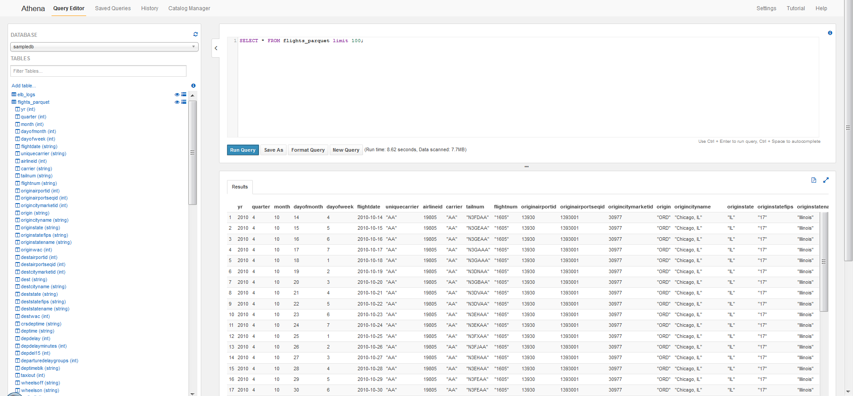
New Flights Parquet Table Created

Slide 23
Save Query Results
When you run an Athena query for the first time, an S3 bucket called "aws-athena-query-results-<account_id>" is created on your account, where "<account_id>" is replaced with your AWS account ID.
The results of all Athena queries are stored in this S3 bucket using the year, month, and day the query was run, the hexadecimal Athena query ID, and the region the query was run in the following format:

Slide 24
3.2 Tuning and Design Patterns

Slide 25
Data Formats and SerDes
Current data formats and SerDes
Standard
CSV, TSV
JSON
Apache web logs
Custom-Delimited Files
Open source columnar formats
Parquet
ORC
Notes:
Your Amazon Athena query performance improves if you convert your data into open source columnar formats such as Apache Parquet or ORC.
You can do this to existing Amazon S3 data sources by creating a cluster in Amazon EMR and converting it using Hive.
http://docs.aws.amazon.com/athena/latest/ug/convert-to-columnar.html
SerDes stands for Serializer/Deserializer, which are libraries that tell Hive how to interpret data formats. Hive DLL statements require you to specify a SerDes, so that the system knows how to interpret the data that you’re pointing to.
Amazon Athena uses SerDes to interpret the data read from Amazon S3. The concept of SerDes in Athena is the same as the concept used in Hive.

Slide 26
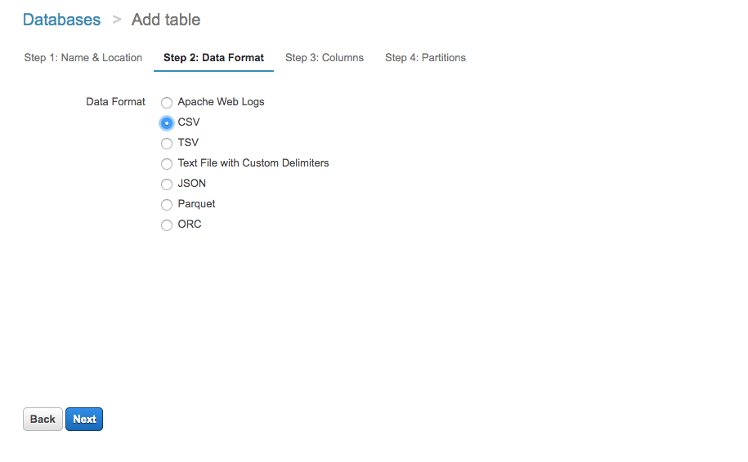
Data Formats in Create Table
Notes:
Amazon Athena supports the following SerDes:
Apache Web Logs: "org.apache.hadoop.hive.serde2.RegexSerDe"
CSV: "org.apache.hadoop.hive.serde2.lazy.LazySimpleSerDe"
TSV: "org.apache.hadoop.hive.serde2.lazy.LazySimpleSerDe"
Custom Delimiters: "org.apache.hadoop.hive.serde2.lazy.LazySimpleSerDe"
Parquet: "org.apache.hadoop.hive.ql.io.parquet.serde.ParquetHiveSerDe"
Orc: "org.apache.hadoop.hive.ql.io.orc.OrcSerde"
JSON: “org.apache.hive.hcatalog.data.JsonSerDe” OR org.openx.data.jsonserde.JsonSerDe

Slide 27
Column Data Types
Column Data Types
Primitives ( Integer, Double, Date, String, Decimal, Varchar…)
ARRAY
MAP
STRUCT
Nested JSON
Query using structures and array of structures
Notes:
Amazon Athena supports both simple data types such as INTEGER, DOUBLE, VARCHAR and complex data types such as MAPS, ARRAY and STRUCT.

Slide 28
Nested JSON
Query
CREATE TABLE users
(Users:array<struct<Id:int,Name:string>>)
Equivalent JSON
“Users": [
{
“Id":123,
“Name": “Abc”
},
{
“Id": 456,
“Name": “Def"
}
]

Slide 29
3.3 Partitions

Slide 30
Partitions
Partition on any column in table
Limits the amount of data each query scans
Common practice
Multi-level time based partition
Example
PARTITIONED BY (year STRING, month STRING, day STRING)
Performance and cost savings on queries filtering by day, month and year

Slide 31
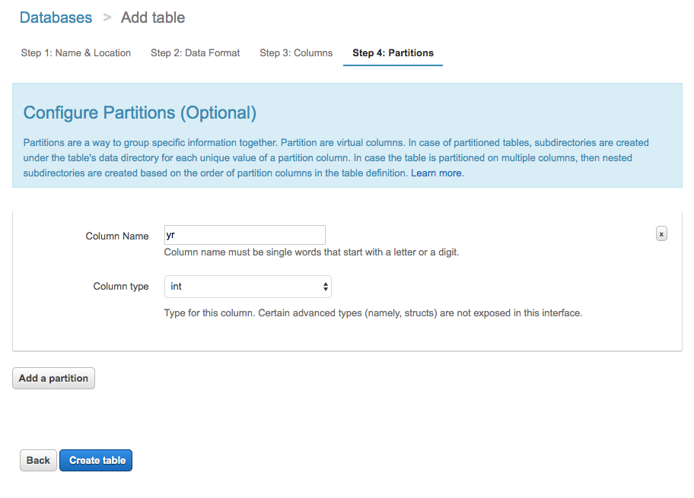
Partitions in Create Table
Notes:
Partition by Year
https://aws.amazon.com/blogs/aws/amazon-athena-interactive-sql-queries-for-data-in-amazon-s3/

Slide 32
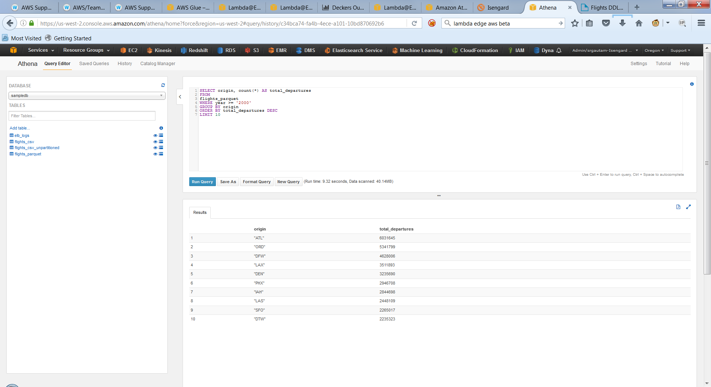
How does partitioning work?
Flight dataset in Parquet
Partitioned by year
Group by query
Top 10 airports with the most departures since 2000
Where year >= 2000
Athena doesn’t have to scan data in partitions before year 2000
Amount of data scanned affects pricing
1 min 6s, 3.11GB for unpartitioned
37.37 s, 2.25GB for CSV
9.32 secs, 0.04GB for Parquet

Slide 33

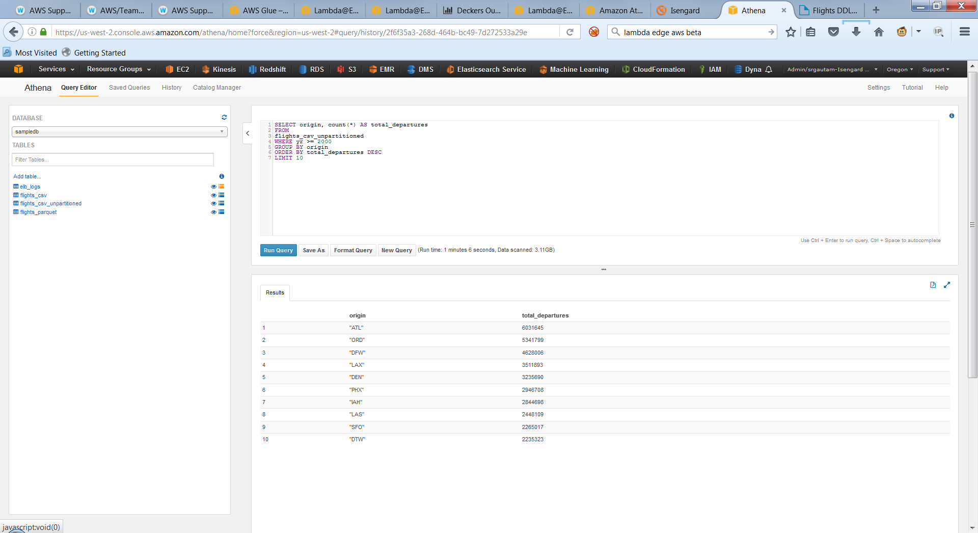
How does partitioning work?
CSV: 37.37 s, 2.25GB
No partitions: 1min 6s, 3.11GB

Slide 34
Convert to Columnar Formats-Parquet/ORC
Convert to Parquet/ORC, use EMR
Create EMR cluster with Hive or Spark
In the step section of create cluster
Specify script in S3, Hive or PySpark
Point to the input data in text/CSV/JSON
Create output data in Parquet/ORC in S3
Monitor cluster status
Create external table in Athena
Convert 1 TB of log files
2-node r3.x8large cluster in US-east
130 GB of compressed Parquet files (87% compression)
Total cost of $5
Notes:
Talk about why convert? Performance and cost savings in columnar formats
http://docs.aws.amazon.com/athena/latest/ug/convert-to-columnar.html
You can use AWS CLI directly to spin up the EMR cluster, using EMR 4.7.0.
Create an Amazon EMR cluster using the emr-4.7.0 release to convert the data using the following AWS CLI emr create-cluster command
To monitor cluster:
aws emr list-steps --cluster-id myClusterID
Or you can run queries against Hive to do the conversion:
The script stores the above impressions table columns from the date, 2009-04-14-04-05, into s3://myBucket/myParket/ in a Parquet-formatted file. The full script is located on Amazon S3 at:
s3://athena-examples/conversion/write-parquet-to-s3.q
PySpark script, about 20 lines long, running on Amazon EMR to convert data into Apache Parquet. The script also partitions data by year, month, and day.

Slide 35
Partition by Running MSCK Repair
If your data is already partitioned in Hive format
Use MSCK repair table command.
To sync all new data in S3 with Hive metastore
Example:
msck repair table flights_csv
show partitions flights_csv
Notes:
https://aws.amazon.com/blogs/big-data/analyzing-data-in-s3-using-amazon-athena/

Slide 36
Partition by Manually Adding Partitions
If data is not partitioned in Hive format
Cannot use MSCK repair table command
Use ALTER TABLE ADD PARTITION to add each partition manually
Look at automating adding partitions
Example:
ALTER TABLE elb_logs_raw_native_part ADD PARTITION (year='2015',month='01',day='01’) location 's3://athena-examples/elb/raw/2015/01/01/'
Notes:
https://aws.amazon.com/blogs/big-data/analyzing-data-in-s3-using-amazon-athena/

Slide 37
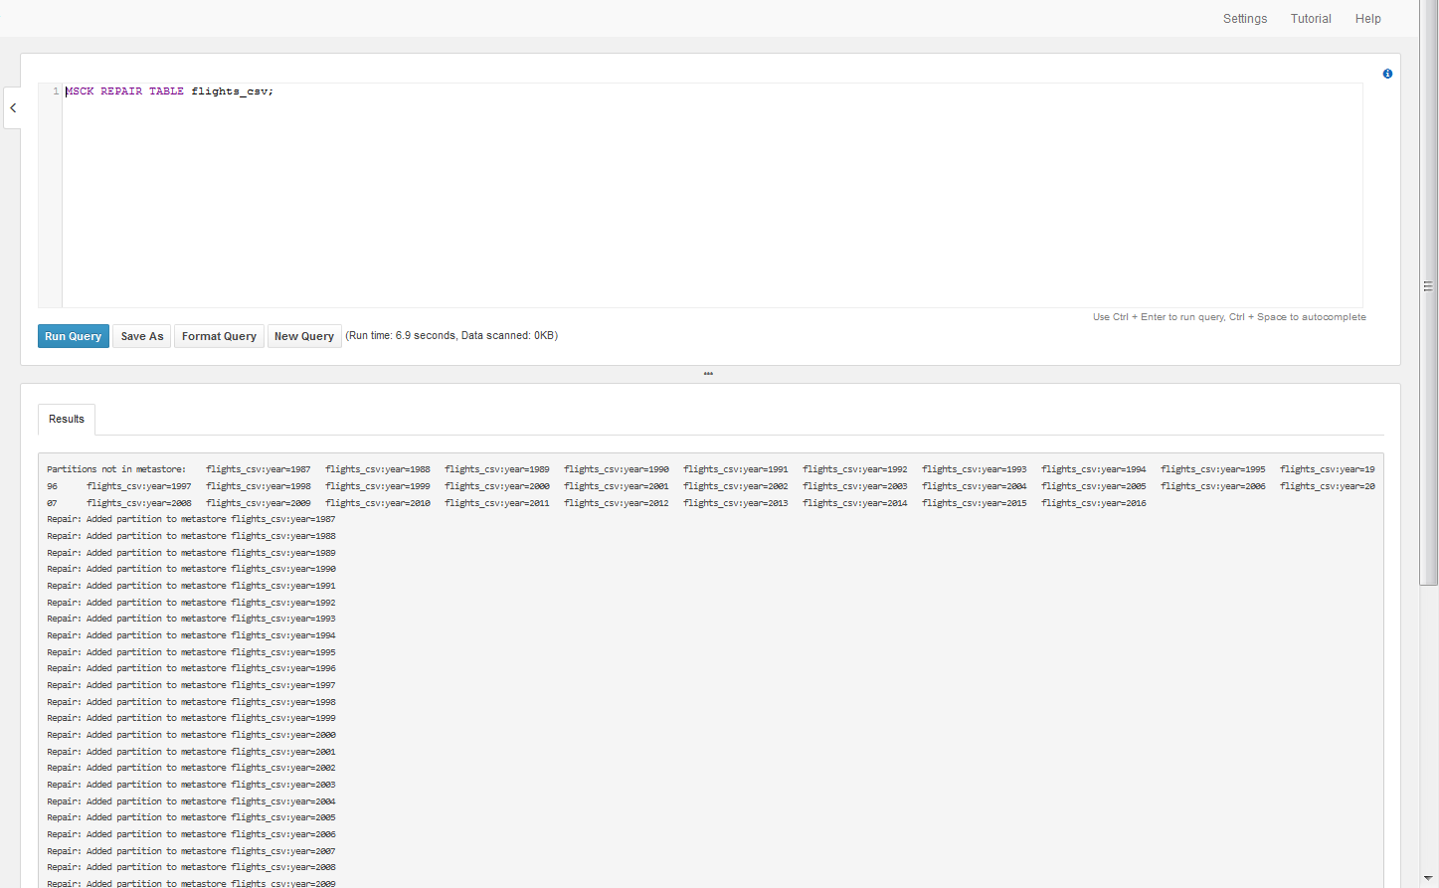
Partitions After Running msck Repair
Notes:
Partitions added for every year of flight data from 1987 to 2016

Slide 38
3.4 Optimize and Secure

Slide 39
Performance and Cost Savings for Compression and Columnar Format
Dataset | Size on Amazon S3 | Query Run time | Data Scanned | Cost
Data stored as text files | 1 TB | 236 seconds | 1.15 TB | $5.75
Data stored in Apache Parquet format* | 130 GB | 6.78 seconds | 2.51 GB | $0.013
Savings / Speedup | 87% less with Parquet | 34x faster | 99% less data scanned | 99.7% savings
(*compressed using Snappy compression)
https://aws.amazon.com/blogs/big-data/analyzing-data-in-s3-using-amazon-athena/
Notes:
https://aws.amazon.com/blogs/big-data/analyzing-data-in-s3-using-amazon-athena/

Slide 40
Access Control for Athena
Access Control
AWS Identity and Access Management (IAM)
Access Control Lists (ACLs)
Amazon S3 bucket policies.
IAM policies for S3
IAM is natively integrated with S3
Grant IAM users fine-grained control to S3
Restrict users from querying it using Athena
Notes:
Amazon Athena allows you to control access to your data by using AWS Identity and Access Management (IAM) policies, Access Control Lists (ACLs), and Amazon S3 bucket policies.
With IAM policies, you can grant IAM users fine-grained control to your S3 buckets.
By controlling access to data in S3, you can restrict users from querying it using Athena.

Slide 41
Access Control Continued
To run queries in Athena, you must have the appropriate permissions for the following:
Athena API actions including additional actions for Athena workgroups
Amazon S3 locations where the underlying data to query is stored.
Metadata and resources that you store in the AWS Glue Data Catalog, such as databases and tables, including additional actions for encrypted metadata.

Slide 42
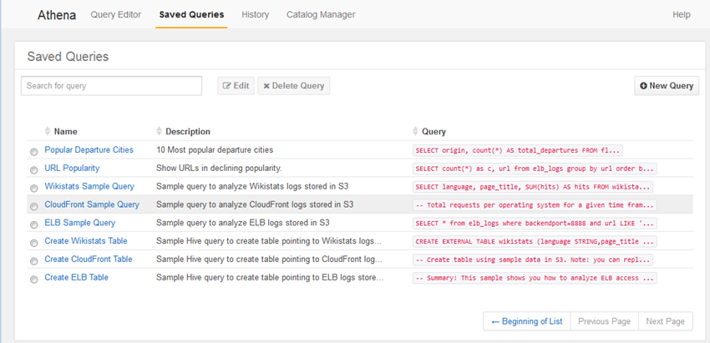
Saved Queries
Notes:
Saved Queries to see all of the queries that have been saved.
https://aws.amazon.com/blogs/aws/amazon-athena-interactive-sql-queries-for-data-in-amazon-s3/

Slide 43
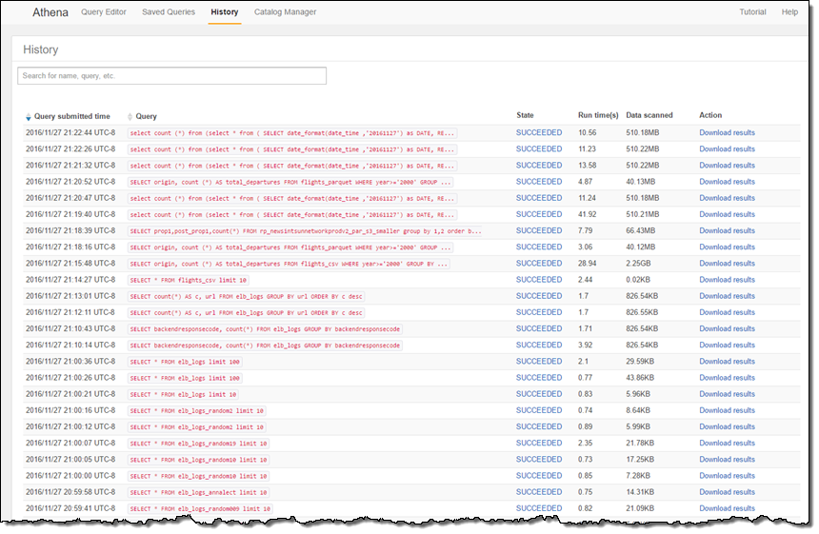
History

Slide 44
Best Practices
Partition your data
Divides your table into parts and keeps the related data together based on column values such as date, country, region, etc
Bucket your data
You can specify one or more columns containing rows that you want to group together, and put those rows into multiple buckets.
Compress and split files
Can speed up your queries significantly
Optimize File Sizes
Ensuring that your file formats are splittable helps with parallelism

Slide 45
Best Practices Continued
Optimize columnar data store generation
Apache Parquet and Apache ORC
Optimize Queries
ORDER BY
JOIN
GROUP BY
LIKE
Use approximate functions
Consider using approx_distinct() for non-exact number queries
Notes:
https://aws.amazon.com/blogs/big-data/top-10-performance-tuning-tips-for-amazon-athena/

Slide 46
3.5 Workgroups

Slide 47
Workgroups
Separate users, teams, applications, or workloads
In order to:
Set limits on amount of data each query or the entire workgroup can process
Track costs

Slide 48
Setting Up Workgroups
Decide which workgroups to create. For example, you can decide the following:
Who can run queries in each workgroup, and who owns workgroup configuration. This determines IAM policies you create.
Create workgroups as needed, and add tags to them.
Open the Athena console, choose the Workgroup:<workgroup_name> tab, and then choose Create workgroup.
Create IAM policies for your users, groups, or roles to enable their access to workgroups.
Specify a location in Amazon S3 for query results and encryption settings

Slide 49
Default Workgroup
By default, if you have not created any workgroups, all queries in your account run in the primary workgroup

Slide 50
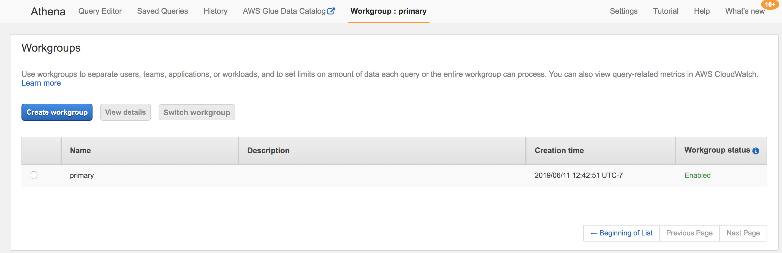

Slide 51
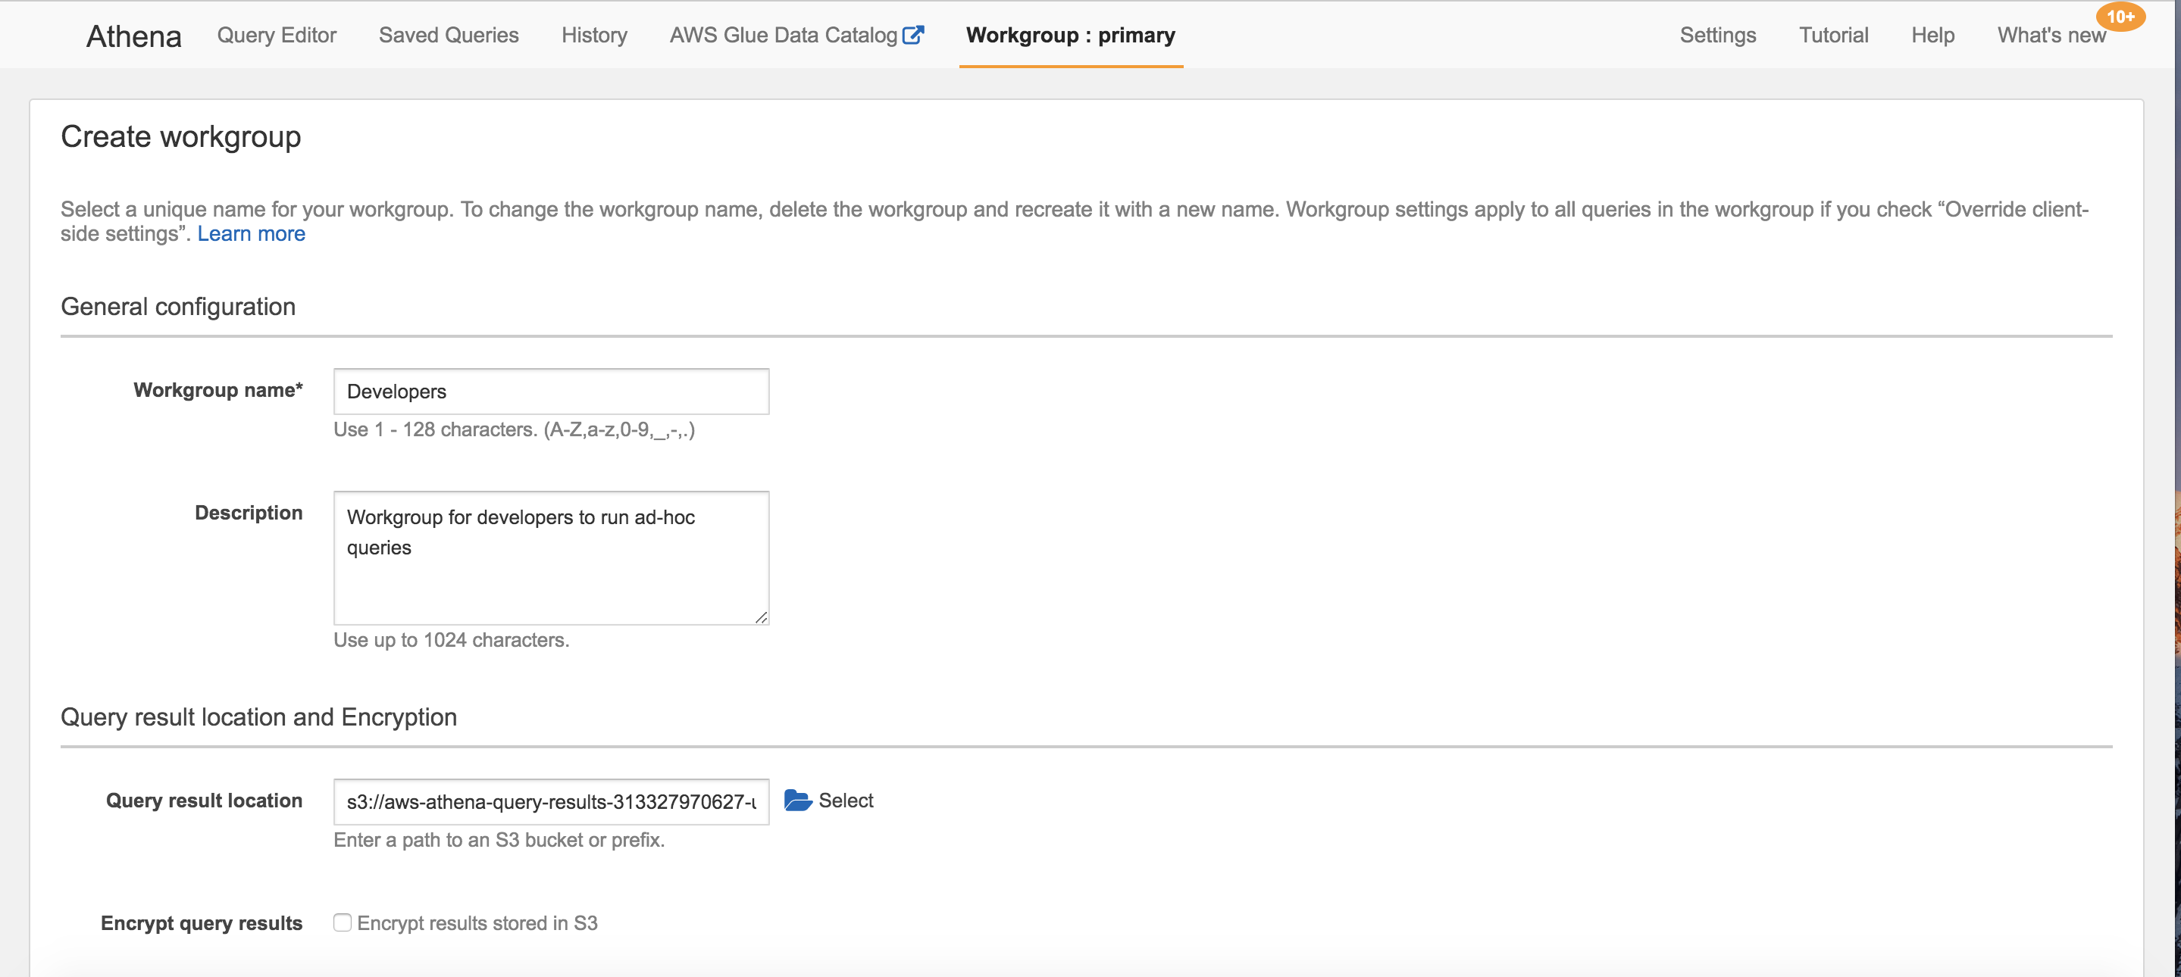

Slide 52
3.6 Views

Slide 53
View
A view in Amazon Athena is a logical, not a physical table.
The query that defines a view runs each time the view is referenced in a query.
Views do not contain any data and do not write data.
Instead, the query specified by the view runs each time you reference the view by another query.

Slide 54
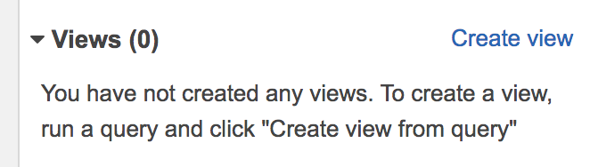
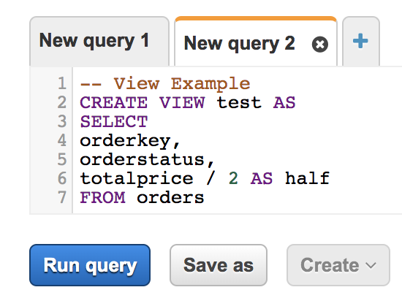
Create a View
Creates a new view from a specified SELECT query.
The view is a logical table that can be referenced by future queries.
Flow:
Create View:
Write View:

Slide 55
3.7 CTAS

Slide 56
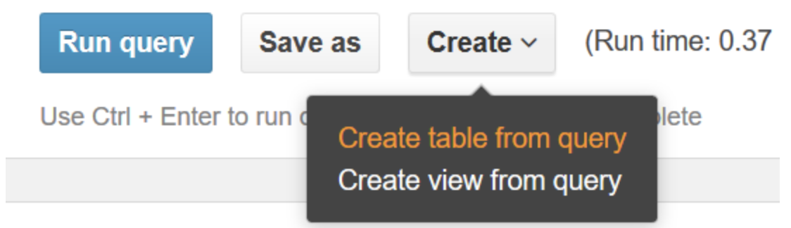
CREATE TABLE AS SELECT (CTAS)
Creates a new table in Athena from the results of a SELECT statement from another query
Athena stores data files created by the CTAS statement in a specified location in Amazon S3

Slide 57
Use CTAS queries to:
Create tables from query results in one step, without repeatedly querying raw data sets. This makes it easier to work with raw data sets.
Transform query results into other storage formats, such as Parquet and ORC. This improves query performance and reduces query costs in Athena.
Create copies of existing tables that contain only the data you need.

Slide 58
3.8 Geospatial Queries

Slide 59
What is a Geospatial Query
Geospatial queries are specialized types of SQL queries supported in Athena
They differ from non-spatial SQL queries in the following ways:
Using the following specialized geometry data types:
Point, line, multiline, polygon, and multipolygon.
Expressing relationships between geometry data types, such as
Distance, equals, crosses, touches, overlaps, disjoint, and others.

Slide 60
Types of Queries
Using geospatial queries in Athena, you can run these and other similar operations:
Find the distance between two points.
Check whether one area (polygon) contains another.
Check whether one line crosses or touches another line or polygon.

Slide 61
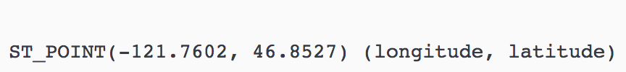
Example
To obtain a point geometry data type from a pair of double values for the geographic coordinates of Mount Rainier in Athena, use the ST_POINT

Slide 62
4. Summary

Slide 63

Key Benefits of Athena
Fast ad-hoc queries
Query directly against data in S3
Use standard ANSI SQL
No infrastructure to setup and manage
Use IAM for security
JDBC driver for BI tools and SQL clients
Pay per query, depending on data scanned

Slide 64
Simple Pricing Example
3 TB of logs on Amazon S3 in text format
Table with 3 equally sized columns
No compression
Athena will scan the entire file
Query cost: $15 (3 TB scanned, 3 * $5/TB = $15)
Compress using GZIP
3:1 compression gains
Query cost: $5. (1 TB scanned, 1 * $5/TB = $5)
Convert to Parquet, columnar format
Athena can read 1/3 columns that is relevant for the query
Query cost: $1.67 (0.33 TB scanned, 0.33*$5/TB= $1.67)
Notes:
Pricing Example
Consider a table with 3 equally sized columns, stored as an uncompressed text file with a total size of 3 TB on Amazon S3. Running a query to get data from a single column of the table, requires Amazon Athena to scan the entire file, because text formats can’t be split.
This query would cost: $15. (Price for 3 TB scanned is 3 * $5/TB = $15)
If you compress your file using GZIP, you might see 3:1 compression gains. In this case, you would have a compressed file with a size of 1 TB. The same query on this file would cost $5. Athena has to scan the entire file again, but because it’s three times smaller in size, you pay one third of what you did before.
If you compress your file and also convert it to a columnar format like Apache Parquet, achieving 3:1 compression, you would still end up with 1 TB of data on Amazon S3. But, in this case, because Parquet is columnar, Amazon Athena can read only the column that is relevant for the query being run. Because the query in question only references a single column, Athena reads only that column and can avoid reading two thirds of the file. Since Athena only reads one third of the file, it scans just 0.33TB of data from S3.
This query would cost: $1.67. There is a 3x savings from compression and 3x savings for reading only one column. (File size = 3TB/3 = 1 TB. Data scanned when reading a single column = 1TB/3 = 0.33 TB. Price for 0.33 TB = 0.33 * $5/TB = $1.67)

Slide 65
Save Cost and Increase Performance
You can save 30%-90% on your query costs and get better performance:
Compressing (Snappy, ZLIB, GZIP)
Partitioning (Time-based)
Converting your data into columnar formats (Parquet, ORC)
Notes:
Q: How do I lower my costs?
You can save 30%-90% on your query costs and get better performance by compressing, partitioning, and converting your data into columnar formats. Each of these operations reduces the amount of data Amazon Athena needs to scan to execute a query. Amazon Athena supports Apache Parquet and ORC, two of the most popular open-source columnar formats. You can see the amount of data scanned per query, on the Athena console.
https://aws.amazon.com/athena/faqs/
https://en.wikipedia.org/wiki/Parquetry

Slide 66

Questions?

